Slide 1

AIML Group Lab Team 5
Autonomous Navigation

Slide 2
Agenda
Problem Statement
Introduction to Team
Response to the Questionnaire (Refer Abstract)
Business Applications, Post course
Q & A

Slide 3
Collision Detection and Warning System
Object Detection – Cars, Pedestrian
Pedestrian Protection System (PPS)
Tracking
Depth Estimation
Real time
Cameras that detect depth
Time to Collide and Alarm System

Slide 4
Team
Siddhant Patra
Neha Mittal
Ramanjee Madasu
Lalitha Sowjanya Susarla
Raja Reddy
Prafulla Malviya

Slide 5
Answers to the Questionnaire (Important info needed)
Annotated dataset which labels cars and people
Number of objects in the path
Speed of car
Video capture
Multiple cameras for calculating depth
Response time of human for an alert
This is a supervised system since we are using annotated data to detect objects.

Slide 6
Datasets
Object Detection and orientation estimation – KITTI
Depth Evaluation and Prediction – KITTI
Object Tracking - KITTI

Slide 7
Deficiencies
Pose – Group of people
Pot- hole detection
More objects can be detected
Weather condition
Reflections to the camera
Direct Sunrays falling on the camera

Slide 8
Answers to the Questionnaire (Pre-processing)
Exposure and gain adjustment
Camera calibration
Image rectification

Slide 9
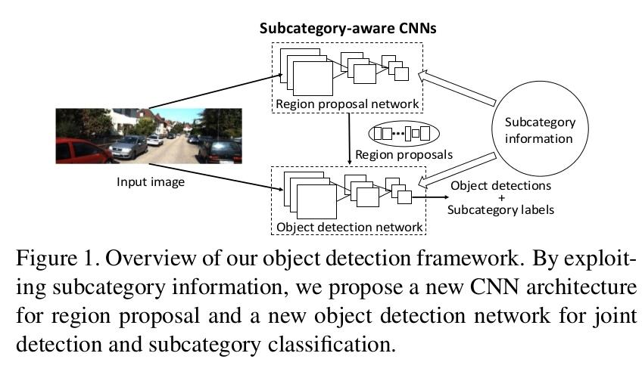
Answers to the Questionnaire (Algorithms)
Algorithm
SubCNN – Xiang et al. (2016) – Need multi GPUs
Metric
Large number of TP, FN, FP
Average Precision

Slide 10
Answers to the Questionnaire (Usefulness)
Avoid collision in real world scenario by alerting the distracted driver
Help in controlling speed
Real-time Pedestrian detection

Slide 11
Post Course
Can be implemented for Indian Highways
Accidents due to negligent drivers should reduce

Slide 12
Q & A

Slide 13
Thank you!

